Slide 1
Waste Management in Indonesia and Society 5.0

Slide 2
Introduction of Waste management in Indonesia

Slide 3
Waste management in Indonesia

Slide 4
Reduce, Reuse and Recycle activities

Slide 5
Waste Bank Activities Overview

Slide 6
Waste Bank Activities in Medan

Slide 7
Opportunity for recycling

Slide 8
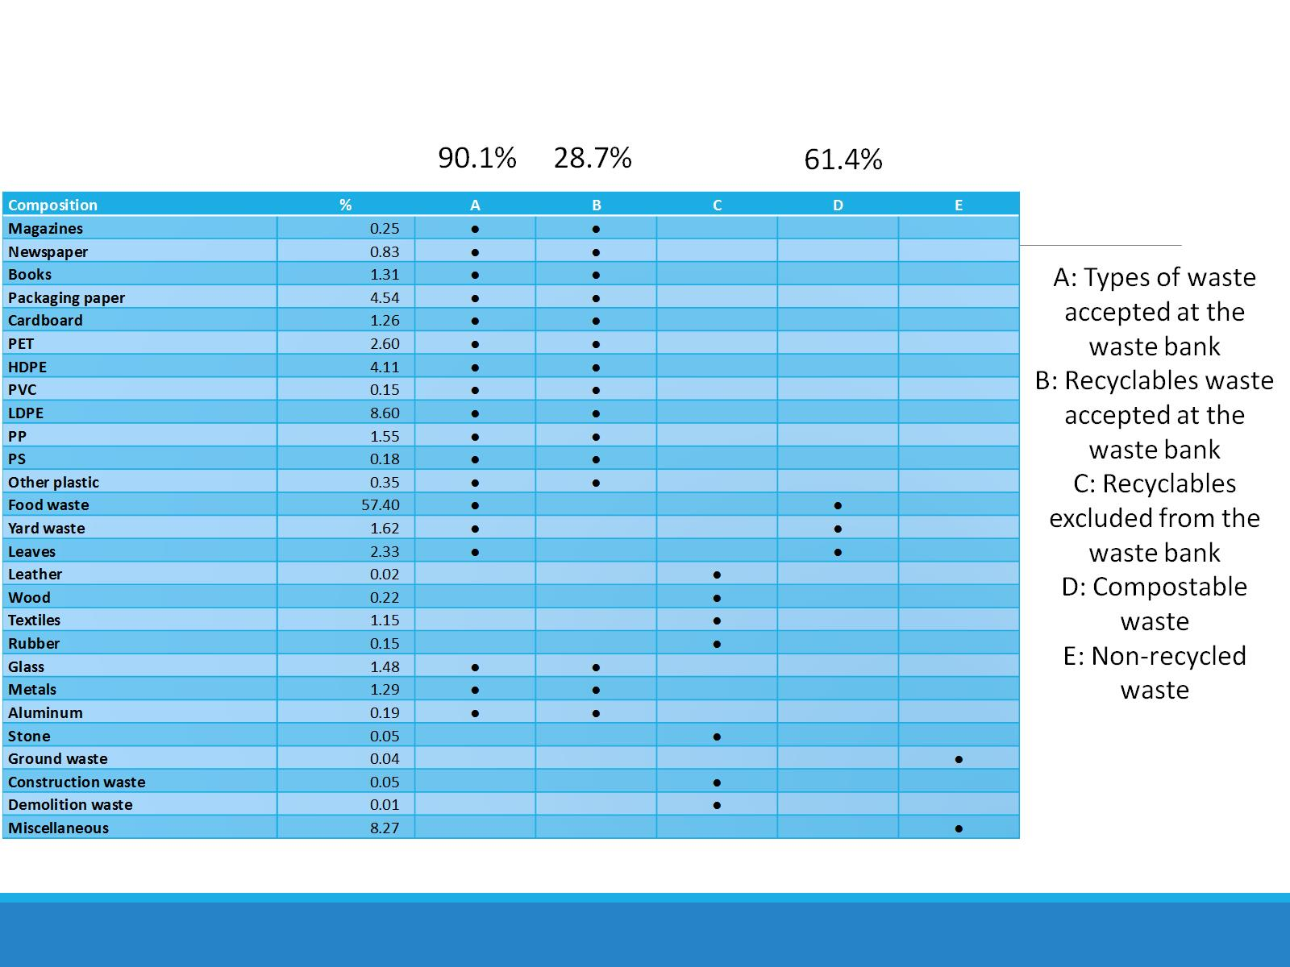

Slide 9
Life Cycle Assessment

Slide 10
System boundary

Slide 11
Life Cycle Inventory

Slide 12
Environmental Assessment

Slide 13
Costs and benefits analysis

Slide 15
Questionnaire survey

Slide 16
Attribute of questionnaire target

Slide 17
Structural Equation Modeling (SEM) using co-variance structure analysis

Slide 18
Structural Equation Modeling (SEM)

Slide 19
Conclusions from SEM

Slide 20
Sophistication of waste management and recycling

Slide 24
Feasibility and Effectiveness Analysis of ICT for Reverse Supply Chain Management

Slide 25
