Slide 4
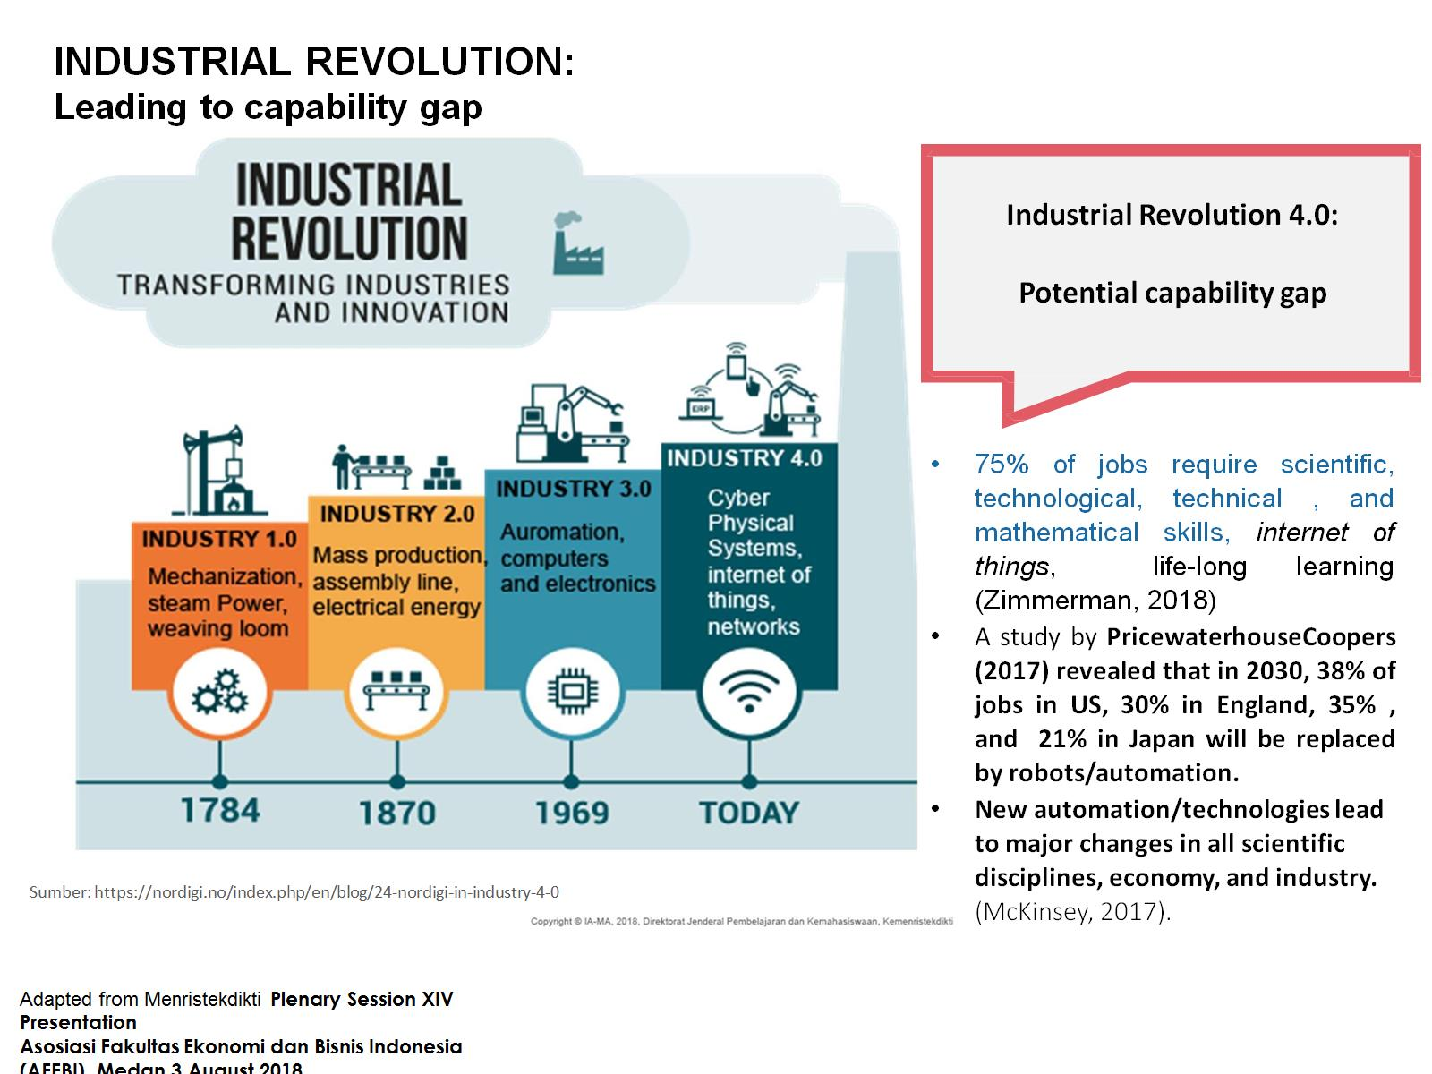
Industrial Revolution 4.0: Potential capability gap

Slide 5
Technological Disruption Era INDUSTRIAL REVOLUTION 4.0

Slide 8
NEW LITERACIES

Slide 9
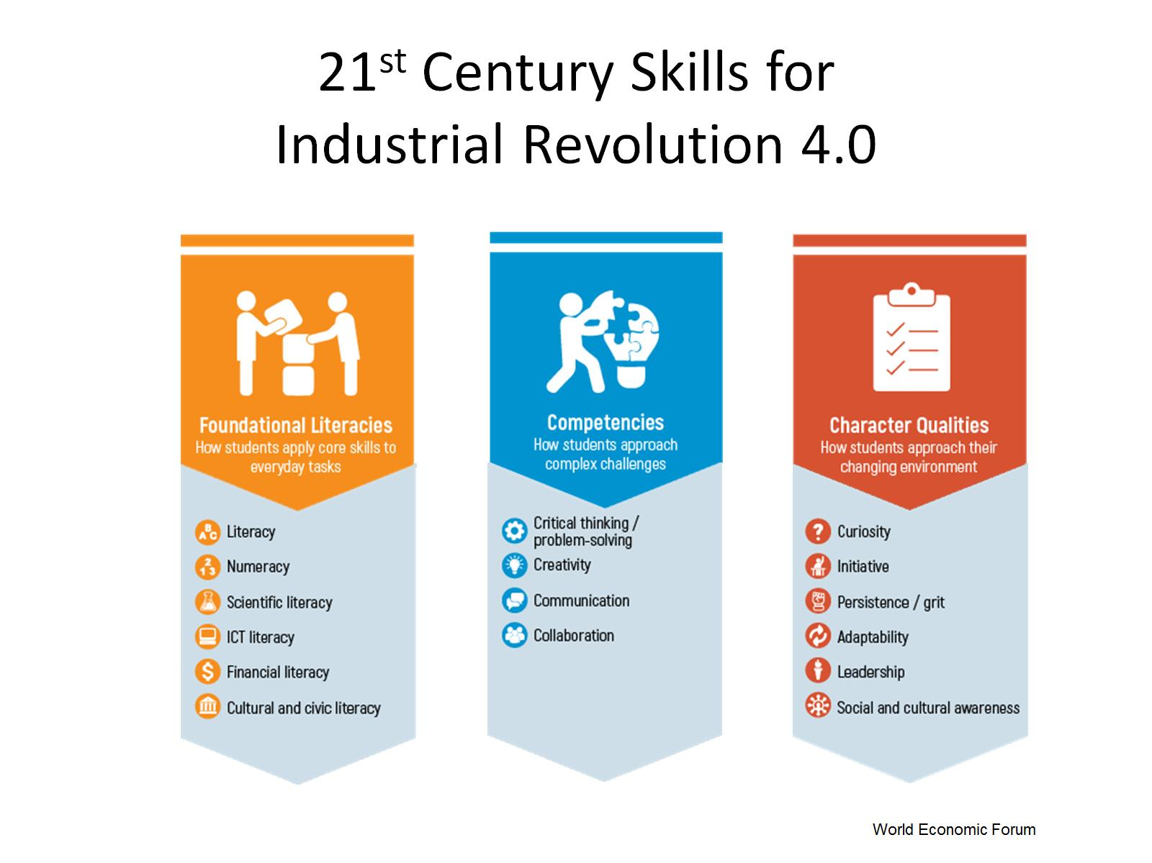
21st Century Skills for Industrial Revolution 4.0

Slide 10
HOTS: Creative and Critical Thinking

Slide 13
